Slide 1

VELAMMAL COLLEGE OF ENGINEERING AND TECHNOLOGY
FIRST REVIEW PRESENTATION
TITLE :Arduino Based Power Saving In Industrial Loads
Presented By: Hrithik Vel.B(913119105022)
Jeyvishnu V.BA(913119105028)
Vijay KrishnaT.K.B (913119105304)
Guided By : Dr.S.Chellam M.E,Ph.D AP III/Dept of EEE, VCET
Date :25-05-2022,Wednesday

Slide 2
Objectives
To minimize the energy consumption and thus reduce the power loss in industries and establishments
Reduces the electricity bill in industries and establishments.
The power factor is also known as the ratio of real power to apparent power. It is also known represented as KW/KVA.

Slide 3
Introduction
Power saver for commercial Establishment, aims to save the energy in industries.
In this we are using shunt capacitors interfaced with arduino.
However, in this project we use shunt capacitors to reduce the power loss in industries. From this, Power factor has also improved.

Slide 4
Literature Survey
Sl.NO | Journal Paper | Author | Title | Description
1 | International research journal of engineering and technology(IRJET) | Dr.Sukhdeo Sao and K.Prasada Rao | Power saver for industrial and commercial establishments by power factor compensation (2019) | Proposed system the lag between zero voltage and zero current pulse duly generated by Suitable operational amplifier modes are fed to two interrupt pins of microcontroller.
2 | International journal of scientifc research and engineering development | Swapnil Namekar and Tushar Sawle | Experimental study on power saver establishment for commercial purpose(2020) | By Installing suitable size power capacitor into circuit the facility factor is improved and therefore the values becomes nearer to 0.9 to 0.95 has minimizing line losses.
3 | International journal of advanced engineering and research development | Mr.Jadhav Rohit, Mr.Bhor Ashish and Miss Handore Saloni | Power saver for industrial and commercial establishment(2018) | The program takes over to actuate shunt capacitors into load circuit to get zero power loss by using 8051 microcontroller.

Slide 5
Problem Identification
In existing power saver methods, Microcontroller based controlling has been employed.
In microcontroller the number of execution is limited due to low memory and it has complex structure.
In proposed system arduino has more memory, easy interfacing, consumes less power compared to other microcontrollers.

Slide 6
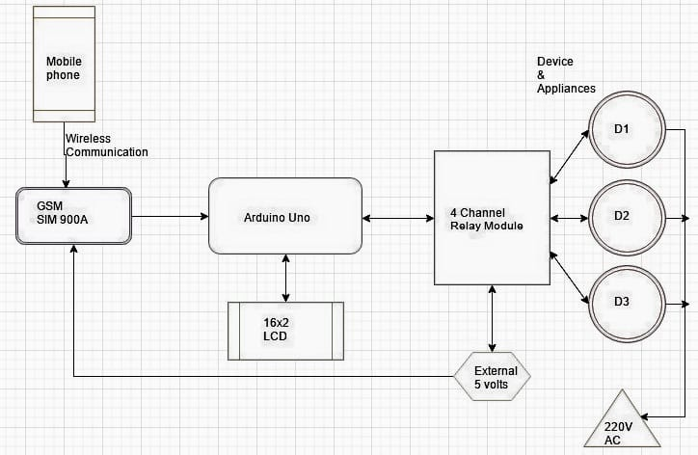
Block Diagram

Slide 7
Work Accomplished
We have collected base papers for our project.
We have identified the proper components.
We presented our paper in ‘Two day national conference on sustainable Infrastructure With Responsible Consumption And Production’ conducted by civil department on 25.03.22

Slide 8
Work Plan
Zeroth Review | Selection of topic. Selection of base paper
First Review | Estimating the price Identify the proper components
Second Review | Executing the project design
Third Review | Rectify the problems and improsive in the project

Slide 9
References
[1]Dr.Sukhdeo Sao and K.Prasada Rao-Power saver for industrial and commercial establishments by power factor compensation-International research journal of engineering and technology(IRJET)-PP.2806-2812-Volume:06 Issue:04-April 2019.
[2]Swapnil Namekar and Tushar Sawle-Experimental study on power saver establishment for commercial purpose-International journal of scientific research and engineering development-PP.732-734-Volume:03 Issue:02-March-April-2020.
[3]Mr.Jadhav Rohit, Mr.Bhor Ashish and Miss Handore Saloni-Power saver for industrial and commercial establishment-International journal of advanced engineering and research development-PP.667-672-Volume:05 Issue:05-May 2018.
[4]Vishal Vaibhav and Varsha Mehar-A review on power saver establishments for industrial and commercial purpose-International journal of engineering sciences and research technology-PP.107-113-Volume:07 Issue:09-September2019.
[5]Mr.Naryanan Swamy.R and Dr.G.Mahadevan-Power Saving Device-International journal of scientific and technology research-PP.14-16-Volume: Issue-August 2012.

Slide 10
[6]Ayman agha, Hani aktar, Audihal fauory and Mohammed R.Khousari-Maximizing electrical power saving using capacitors-Benthem science publishers-PP.1-11-February 2020.
[7]M.Balavigneshwari –Power saving management-International journal of advanced research in management, architecture, technology and engineering(IJARMATE)-PP.5-13-Volume:02 Issue:05-May 2016.
[8]Maryam Nabihah Zaidi and Adlan Ali-Power factor improvement using automatic power factor compensator(APFC) Device-MATEC web of conference-PP.1-6-2017.

Slide 11
Thank You

